Slide 1



The Future of Exoplanet Imaging: the Fast Atmospheric Self-Coherent Camera Technique
Benjamin Gerard
C. Marois, R. Galicher, J.-P. Véran, GPIES collaboration, NEW EARTH group, KAUST computational imaging group, NRC photonics group
The GPI project has been supported by Gemini Observatory, which is operated by AURA, Inc., under a cooperative agreement with the NSF on behalf of the Gemini partnership: the NSF (USA), the National Research Council (Canada), CONICYT (Chile), the Australian Research Council (Australia), MCTI (Brazil) and MINCYT (Argentina).
Notes:
~60 students+posdocs, ~40 faculty

Slide 2
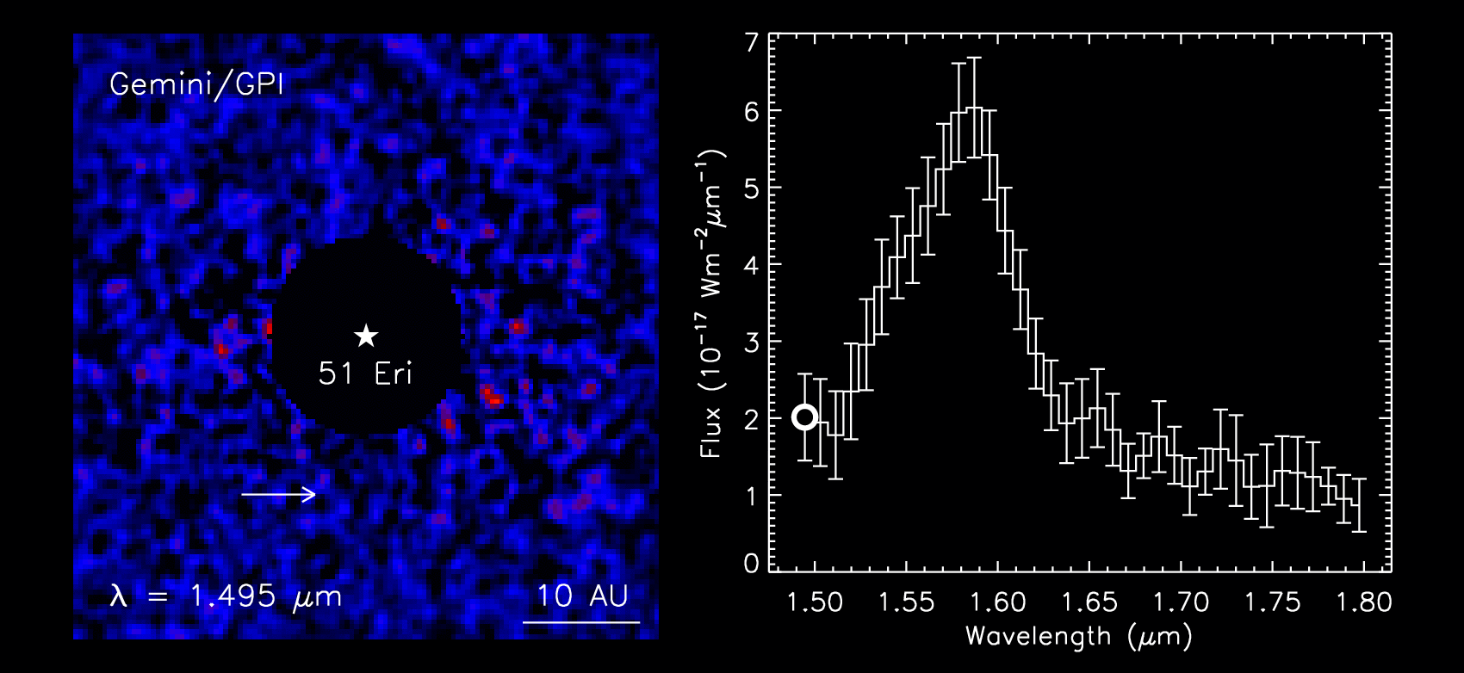

Macintosh et al. 2015

Slide 3
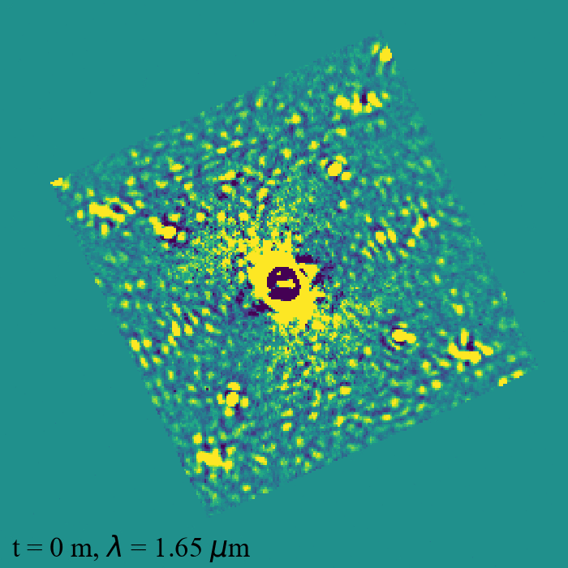

51 Eri, raw
PSF stability: time-dependent speckle evolution
  Quasi-static aberration (whole image)
  Residual-AO aberration
Chromaticity: wavelength dependent speckle evolution

Slide 4
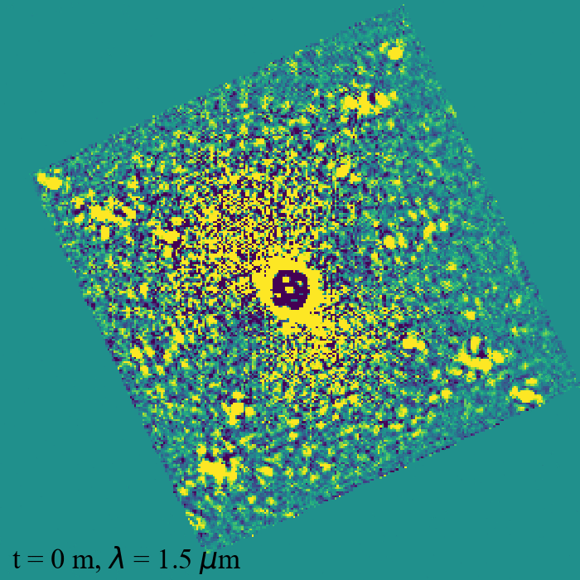

51 Eri, raw
PSF stability: time-dependent speckle evolution
  Quasi-static aberration (whole image)
  Residual-AO aberration
Chromaticity: wavelength dependent speckle evolution

Slide 5
Outline
Speckle Subtraction via Coherent Differential Imaging
  Overview
  Self-coherent camera (SCC)
  Fast Atmospheric SCC Technique (FAST)
    Post processing
    DM control (focal plane wavefront sensing)
Ongoing FAST work
Possible FAST collaborations with LAM

Slide 6
Possible FAST interests with LAM
FAST AO control theory
  w/ J.-P. Véran, C. Correia
SCC FPM design optimization/fabrication
  AO WFS, linearity, dynamic range
  Lessons learned from ZWFS?
RTC architecture
LOWFS
  w/ R. Galicher, P. Baudoz, G. Singh
Chromaticity
  lessons learned from SPHERE?

Slide 7
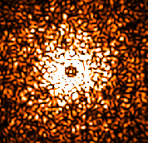
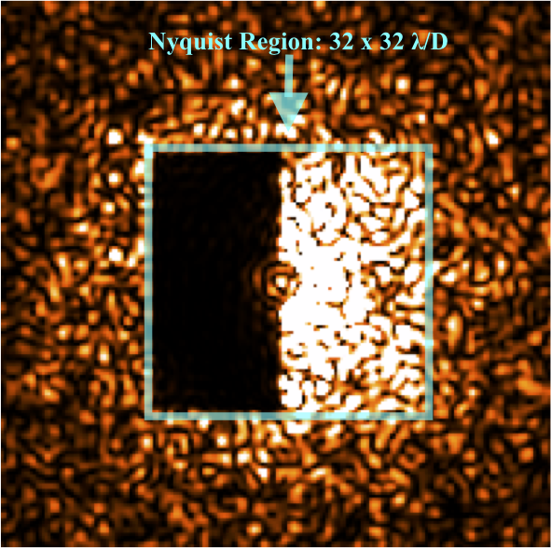
Coherent Differential Imaging (CDI)
exoplanet light is transmitted (not coherent w/starlight)
  Post-processing: PSF reconstruction and subtraction
  Wavefront sensing and control: use one DM to subtract starlight in (at most) half the AO control radius (below)
before
after
e.g., Guyon 2004; Bordé & Traub 2006; Baudoz et al. 2006; Give’On et al. 2007; Serabyn et al. 2011; Sauvage et al. 2012; Jovanovic et al. 2018
Notes:
1 min max

Slide 8
focal plane wavefront sensing
Science camera is now a WFS
Some advantages
  No NCPA
  Very good sensitivity
  Can measure amplitude aberration (e.g., scintillation)
Some disadvantages
  Can take a while to converge
  Generally less dynamic range
deformable mirror (DM)
Real time controller (RTC)
RTC
dichroic
Science camera/ high order WFS (HOWFS)/ focal plane WFS
coronagraph/ low order WFS (LOWFS)
wavefront
Sensor
(WFS)
RTC

Slide 9
FAST—The Fast Atmospheric Self-Coherent Camera (SCC) Technique
Gerard, B., Marois, C., Galicher, R., AJ, 2018, 156, 106

Slide 10
Self-Coherent Camera
Baudoz et al. 2006; Galicher et al. 2010

Slide 11
Self-Coherent Camera
Baudoz et al. 2006; Galicher et al. 2010

Slide 12
Self-Coherent Camera
Baudoz et al. 2006; Galicher et al. 2010

Slide 13
Self-Coherent Camera
Baudoz et al. 2006; Galicher et al. 2010

Slide 14
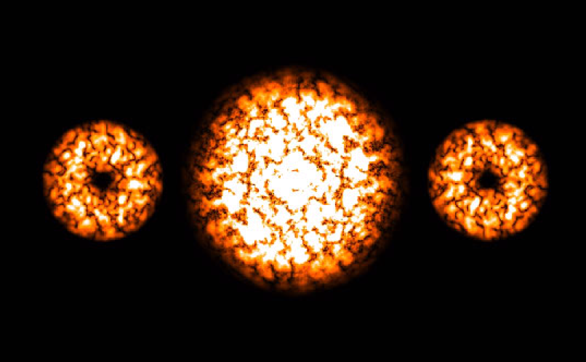
SCC MTF

Slide 15
Notes:
----- Meeting Notes (19-03-13 10:51) -----
note: simulated images

Slide 16
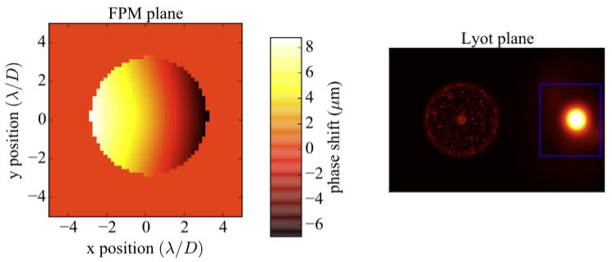
SCC FPM
Notes:
Ideally want 3X smaller → IWA=9 lambda/D

Slide 17
With SCC FPM
m_{H}=0
t_{int}=1 ms
λ=1.65 μm
Δλ/λ=1%

Slide 18
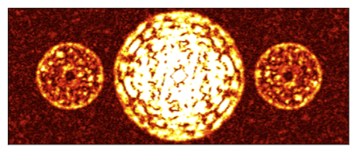
MTF
(m_{H}=0, t_{int}=1 ms)

Slide 19
FAST post-processing
Gerard, B., Marois, C., Galicher, R., AJ, 2018, 156, 106

Slide 20
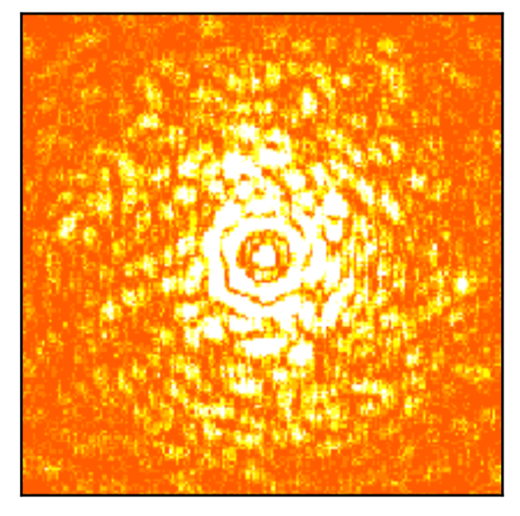
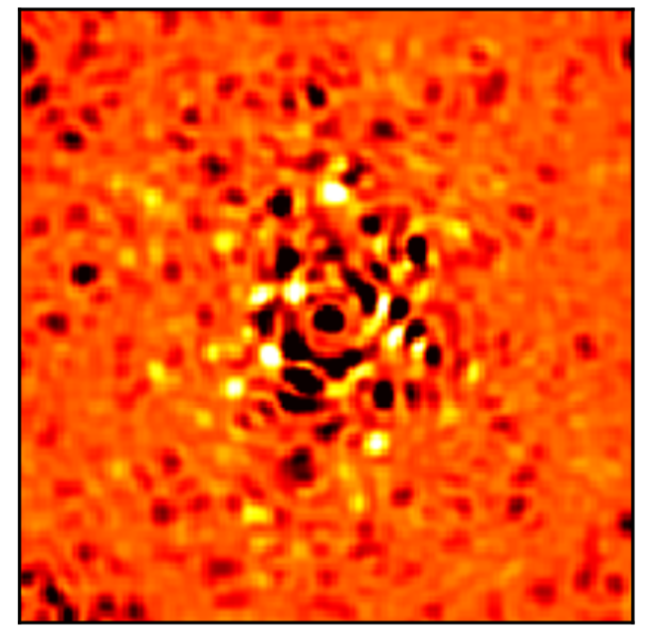
CDI Subtraction Algorithm(s)
in:
out:
Algorithmic (above; CDI), and/or
DM control (later; focal plane wavefront sensing)

Slide 21
FAST post-processing

Slide 22
Before vs. After

Slide 23
FAST DM Control
Gerard, B., Marois, C., Galicher, R., Véran, J.-P., Proc. SPIE, 2018, 170351

Slide 24

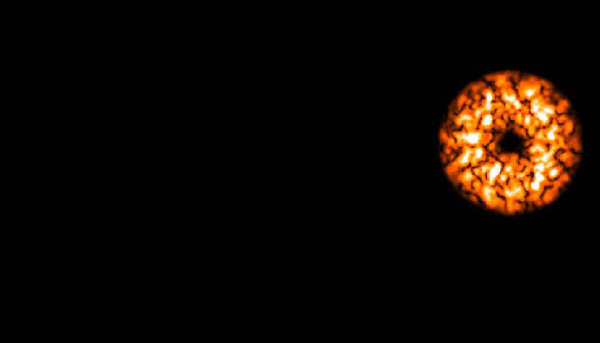
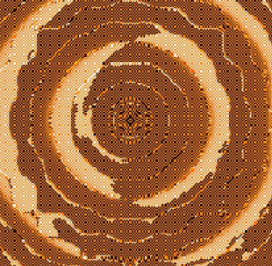
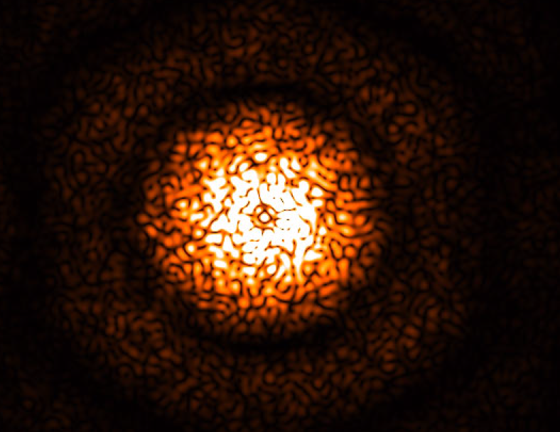
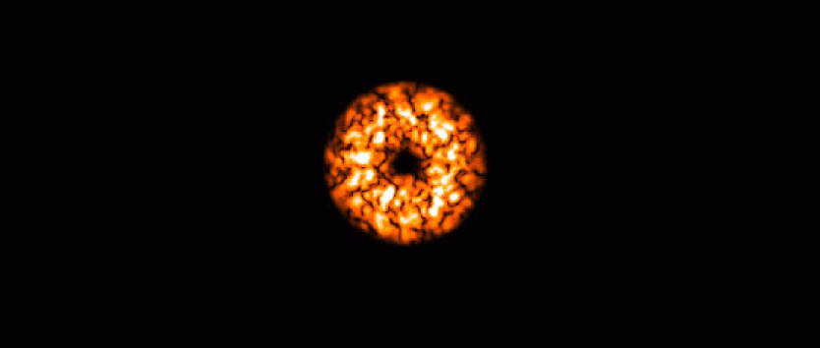
Wavefront Sensing Algorithm
shift
Phase (only use with DM)
Amplitude = |A_{s}||A_{r}|
IFT

Slide 25
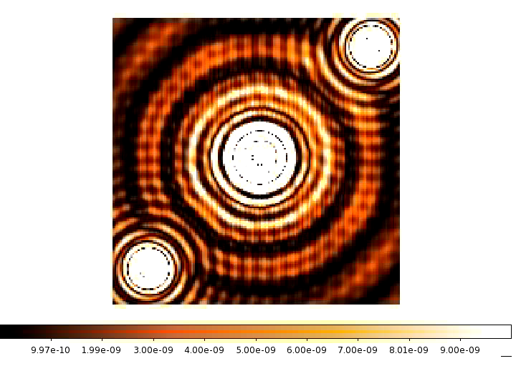
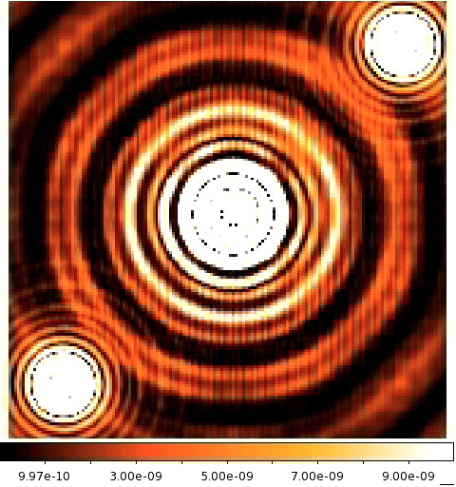
Least-Squares Reference Images
sine:
cosine:
Build IM in I₋ (PSF fringes)
Various “tricks” to improve sensitivity, linearity, contrast, dynamic range, etc.

Slide 26
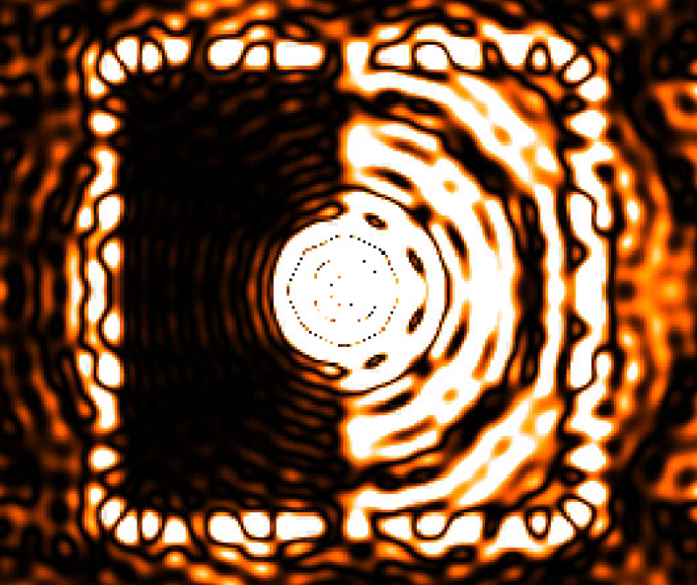
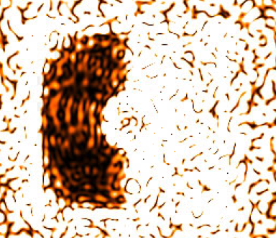
Classical Static Correction
No WFE
100 nm rms, 5% amplitude error
5σ contrast: 5e-10 9e-6

Slide 27
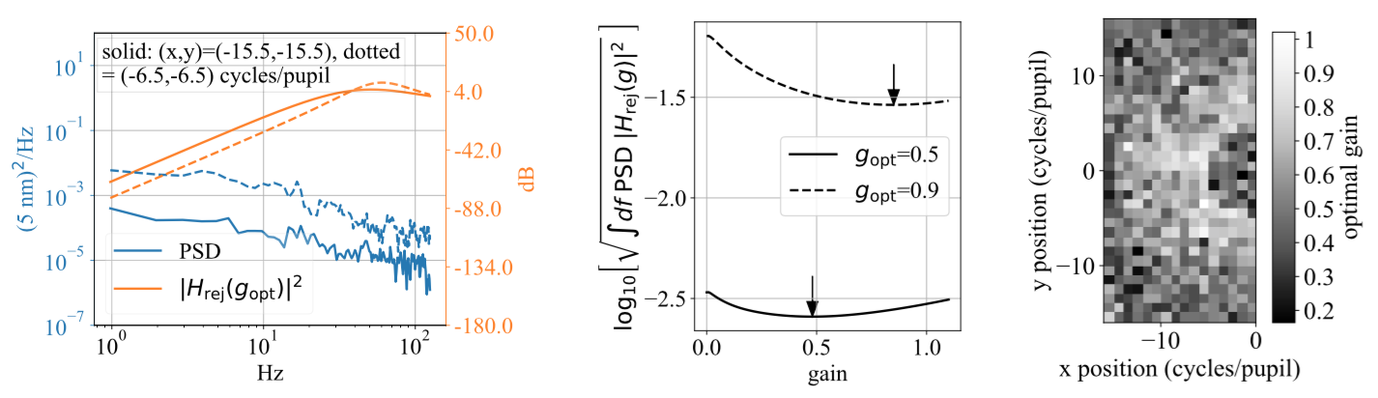
FAST dynamic correction

Slide 28
FAST Conclusions
New FPM design → SCC fringe detection on millisecond timescales, which allows
  CDI PSF subtraction
  DM control
  of residual atmospheric and quasi-static aberration
In principle, 1 A and B will allow reaching contrast at the photon noise limit vs. time
Still lots of work to validate 1 and 2

Slide 29
Future/ongoing FAST work

Slide 30
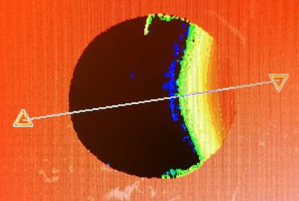
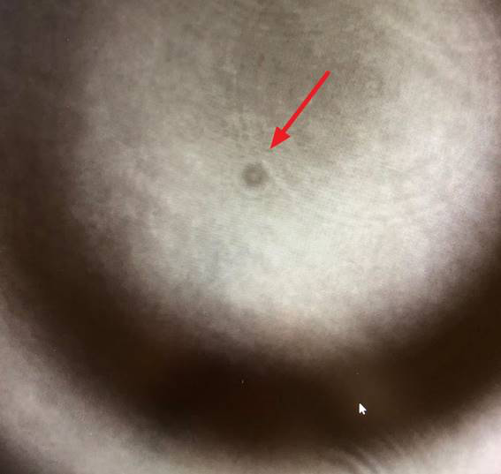
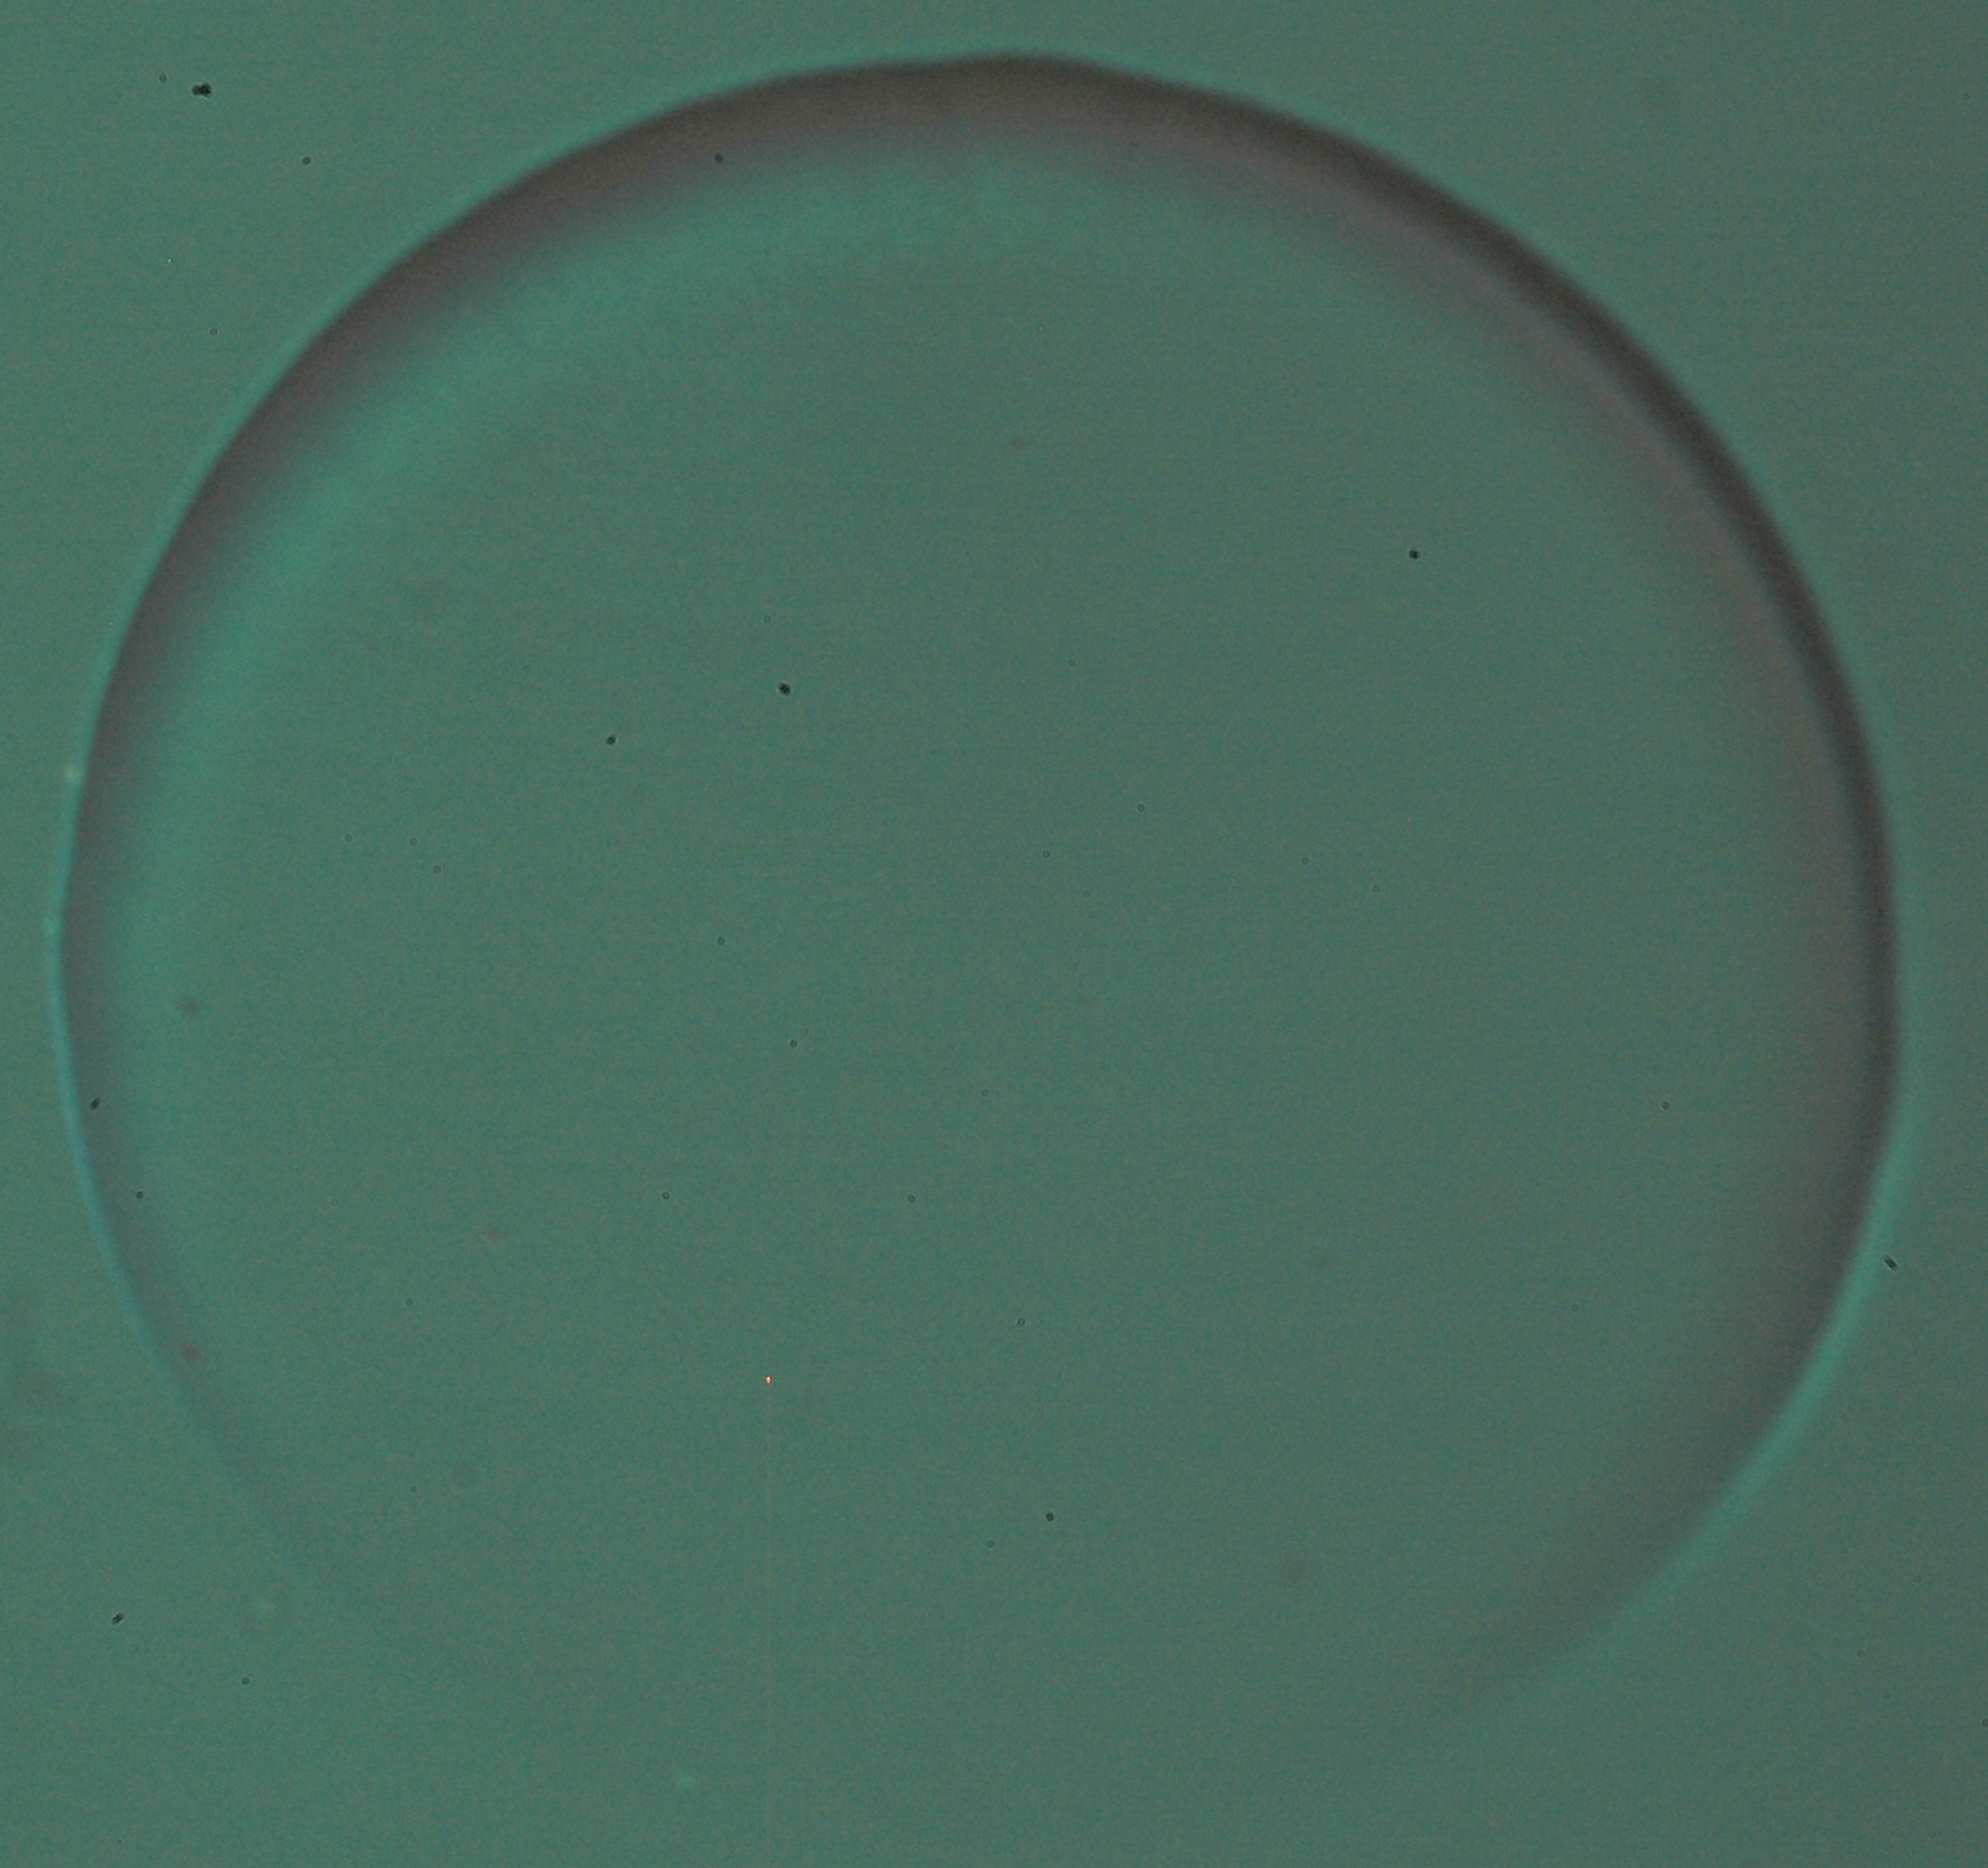
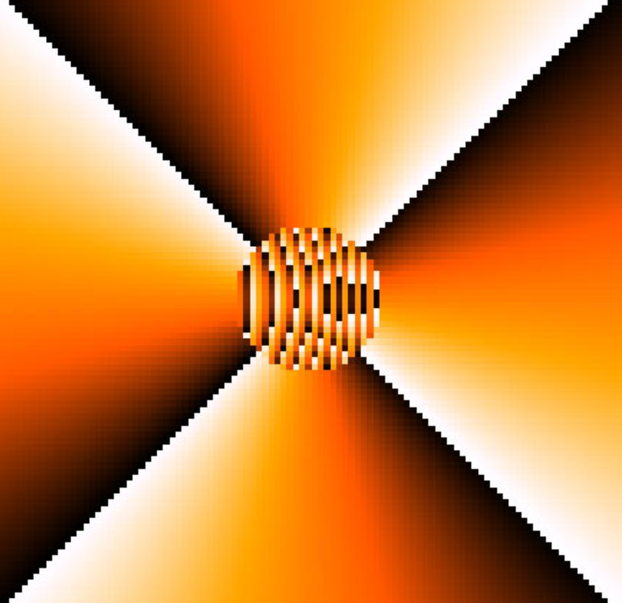
SCC FPM fabrication and testing
KAUST:
U. Laval:
version 1: NEW EARTH (PI: me)
  KAUST: fabrication, U. Laval: coating
  Testing ~April and beyond
version 2: THD2 (PI: R. Galicher)
  2 lambda OPD (PV)
  testing right now
version 3+: the future
  Working with NRC photonics group (PIs: P. Cheben, S. Janz) and others

Slide 31
LESIA testing, corono lab*
Design optimized for THD2 lab, not corono lab
THD2 FPM alignment and tests starting Monday!

Slide 32
FAST LOWFS
Possible GPI Upgrade
Design reflecting rejected light from Lyot
Designing to optimize linearity vs. sensitivity, etc.
Using telemetry to do CDI post-processing
Talk to me if interested
Possible funding through the Canadian Foundation for Innovation (CFI)
~2-3 year timescale, if funded
Talk to Christian Marois if interested

Slide 33
Possible FAST interests with LAM
FAST AO control theory
  w/ J.-P. Véran, C. Correia
SCC FPM design optimization/fabrication
  AO WFS, linearity, dynamic range
  Lessons learned from ZWFS?
RTC architecture
LOWFS
  w/ R. Galicher, P. Baudoz, G. Singh
Chromaticity
  lessons learned from SPHERE?

